Slide 1
SHIPT
Your groceries,
delivered.

Slide 2
What is this all about?
Shipt is an app that provides grocery and alcohol* delivery from your local store via a local community of reliable shoppers. Become a member, order from your phone or computer, and we’ll bring your order straight to the location requested.
Eliminate trips to the store, and save time!
*Alcohol delivery available with select partners in some cities.

Slide 3
Vision& Purpose
It is founded on the mission of simplifying lives,Shipt serves members, shoppers, and communities by offering convenience and freedom.
Through a user-friendly app and a local network of reliable shoppers,Shipt connects members to a fresh groceries and everyday essentials.
Saving time, fuel and headspace,next-hour,same day grocery delivery is quickly becoming an everyday necessity for people looking an extra few hours and intentional food choices.

Slide 4
Personas& Target Customers
Persona Type 1
Persona Type 2
Busy Parents
Parents with 2 or more children
Age 35+
University Graduates
High Income house hold($80,000+)
Tech Savy
Spend a lot of time with children
Avid Web Users
Very busy work schedules
Stay at home most weekends(leisure or work)
Owns 2 vehicles
Lives in a house
Individuals without Personal Transportation
Single M/F individuals
Age 25+
University Graduates
Some still attend graduate school
Midsize income($45,000+)
Tech Savy
Avid Web Users
Lives in an apartment
They make use of the product occasionally depending on the amount of groceries they need
It’s seen as an early adoptor

Slide 5
Shopper
Stores
People who have a smartphone and a car
People who love shopping
People who want to work as a freelance shopper
Those who want to increase their sales
Those who want to reach out to more people.

Slide 7
Next Important Big thing!
Hypotheses
Success Metrics
H1:Ability to track spending habits-This is important for the users in order to cut down the shopping costs and handling the family budget.An infographic feature can be built and indicate how and where users have spent their money and some recommendation on how they can cut down this expenditure can be provided.
H2:Item Re-fill Reminder-This is for busy people who don’t remember to shop.Adding this feature will remind them after a certain time.
H3:Adding Nutritional Value-This feature helps users to access as much as product information as they want in the shortest period of time.
H4:One Membership for two different users-This can be availed for the new users until 6 months or 1 year which increases new signups.
H1S1: Overall Customer Experience and Revenue is increased.
H2S2:The Retention rate is increased.
H3S3:Increase in Average Order Value
H4S4:Increase in Conversion Rate.

Slide 8
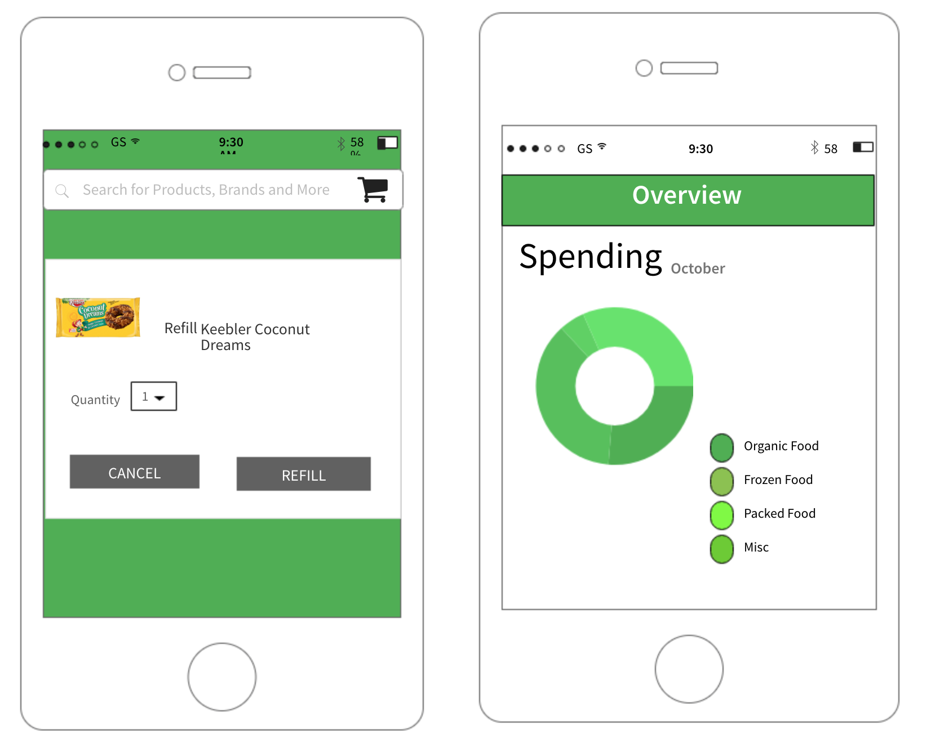

Slide 9
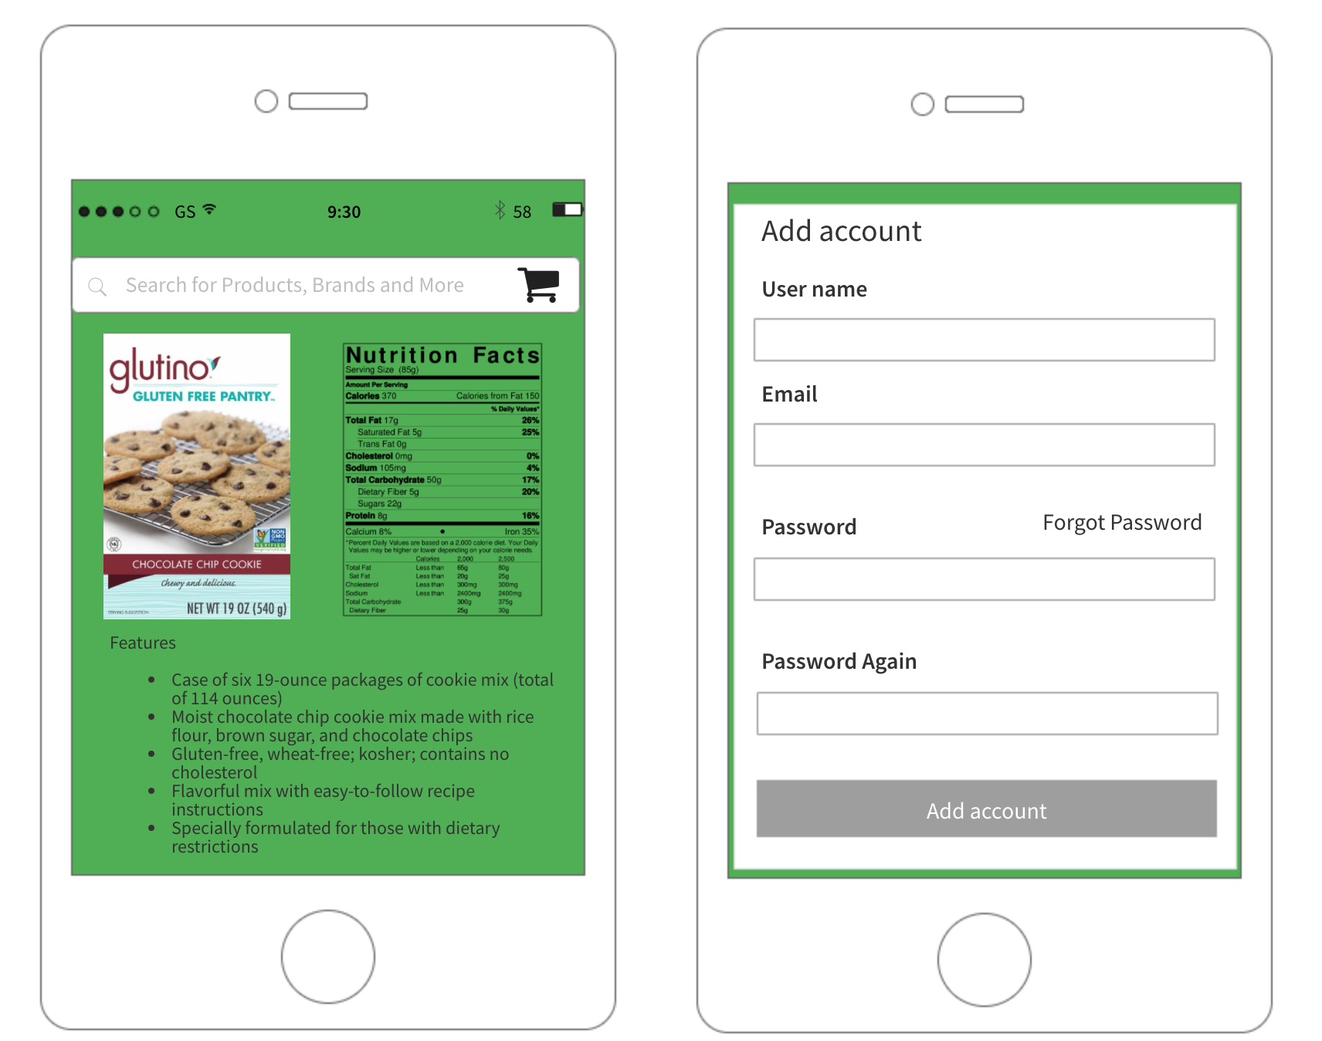

Slide 10
Competitive Analysis
I validated my hypotheses by performing a competitive analysis based on web built information
Kindly click/paste this link: https://app.xtensio.com/folio/rhmc77zx

Slide 11
PRD- Shipt Model
Objective:
To increase the overall customer experience and revenue of the company.
Success Metrics:
Overall Customer Experience and Revenue is increased.
The Retention rate is increased.
Increase in Average Order Value
Increase in Conversion Rate

Slide 12
Use Cases:
For Busy Parents and Individuals without Personal Transportation.
For Individuals who own a car and a smartphone and want to do some freelancing.
For Stores who want to increase their sales and expand.
User Stories:
#1: An infographic feature is built and indicate how and where users have spent their money and some recommendation on how they can cut down this expenditure can be provided.This gives them more health centric information.
#2: An Item Re-Fill Reminder feature pops up at a certain period during week for busy people who don’t remember to shop.Adding this feature will remind them after a certain time.
#3: Adding Nutritional Fact to certain products helps users to access as much as product information as they want in the shortest period of time.
#4: Sharing one membership with two accounts can be availed by the new users when they signup until 6 months or 1 year which increases new signups.

Slide 13
Thank You!

